Slide 1
HU150: Professional Communication
Dr.unais kt

Slide 2
Unit 1: Principals of Professional Communication

Slide 3
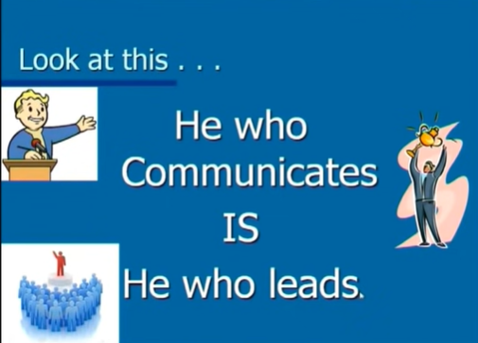

Slide 4
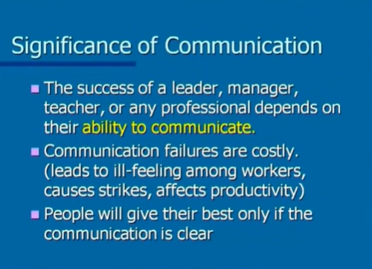

Slide 5
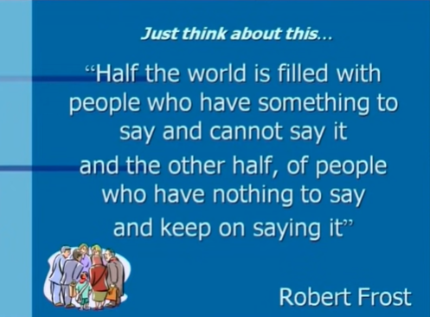

Slide 6
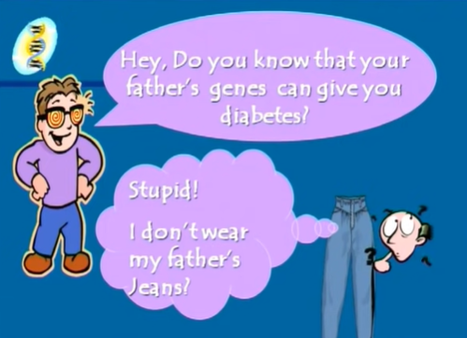

Slide 7
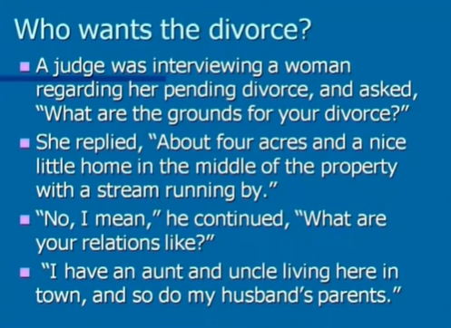
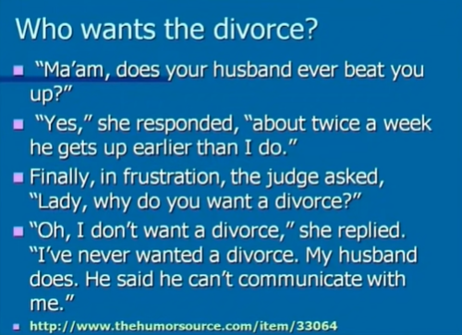

Slide 8
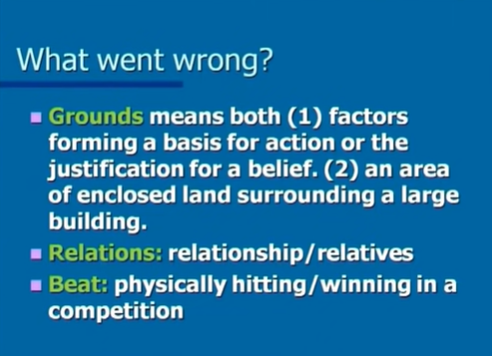

Slide 9
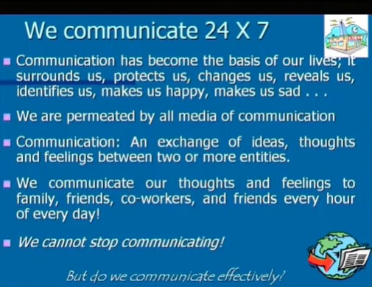

Slide 10
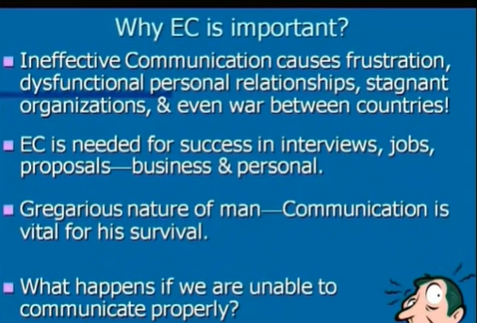

Slide 11
Origin, Definition and Meaning
Origin- comes from the Latin word 'communicare' or 'communico' which means 'to share' or 'to make known '.
Definition- “Communication is an exchange of facts , ideas, opinions or emotions by two or more persons”. - William Newman & Charles Summer
“Communication is the process by which information is transmitted between individuals and/or organisations so that an understandable response results”. - Peter Little.
Meaning- Various researchers have defined in their own simplest way to briefly sum up will be "communication essentially means the transfer of ideas, feelings, plans, messages, or information (through speech, signal, writing- verbally and non verbally) from one person to another". It considered effective only when it gets the desired action or response.

Slide 12
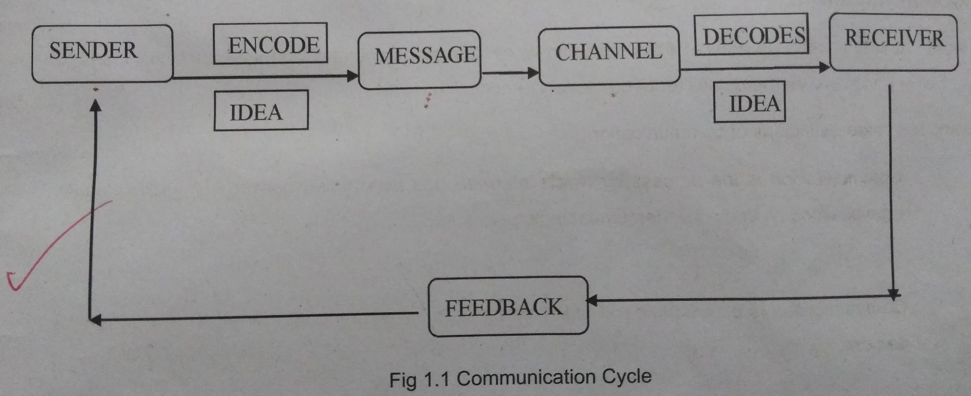
Process of Communication

Slide 13
Continue….
Sender: The person who initiates the communication process is referred to as the encoder. The process of communication begins with the sender who identifies the need to communicate.
Encoding: Encoding takes place when the sender formulates his idea into a message to be transmitted to the receiver, using a series of symbols- verbal/ or non-verbal, written or oral. The sender should encode the message keeping in mind the purpose of communication and should select words or symbols that help the receiver understand the communication correctly and to achieve the expected feedback.
Message: A message is an idea transformed into words. It can be expressed in different ways depending upon the subject-matter, purpose, audience personal style and cultural background of the sender

Slide 14
Continue….
Channel and medium: An appropriate medium chosen to send the message is known as channel. It is the vehicle which facilitates the sender to convey the message to the receiver. Channel is a system used to transmit a message, whereas medium is one of the forms/ types used under that system. For example oral communication is a channel and telephone conversation is a medium.
Receiver: The person who receives the encoded message is referred to as receiver. The receiver may be an individual or a group of individuals.
Decoding : It is a process by which the receiver interprets the message and translates it into meaningful information.
Feedback : Feedback is the response given by the receiver of the message to the sender of the message. When the encoder receives feedback, he gets to know that communication has been accomplished

Slide 15
Classification
Verbal Communication
Non verbal Communication

Slide 16
Verbal Communication
Oral Communication.
It refers to speaking with the help of words.
Proper pronunciation and tone is the key to effective oral communication.
Advantages and disadvantages.
Written Communication
Messages when conveyed with the help of written words.
It requires command over the language, correct construction of sentences, appropriate use of words, logical sequence of points, etc,.

Slide 17
Non verbal Communication
Communication without words
Kinesics- Body language
Proxemics- the distance
Oculesics- technical term for eye contact
Chronemics- the utilization of time
Artefacts- momento, remembrance
Haptics- different touches
Olfactics-sense of smell
Chromatics-use of colour
silence

Slide 18
Types of Communication

Slide 19
Different forms of communication
On the basis of means, kinds, manners, forms
Verbal- Oral and Written
Non-verbal - Kinesics, Proxemics, Oculesics, Chronemics, Artefacts, Haptics, Olfactics, Chromatics and silence
On the basis of levels
Extrapersonal
Intrapersonal
Interpersonal
Mass
Organizational
On the basis of Flow
Vertical
Horizontal
Diagonal

Slide 20
Levels of communication

Slide 21

Extrapersonal Communication
Communication between human beings and nonhuman entities is extrapersonal.
Example: Your pet dog comes to you wagging its tail as soon as you return home from work.
This form of communication requires perfect coordination and understanding between the sender and the receiver.

Slide 22
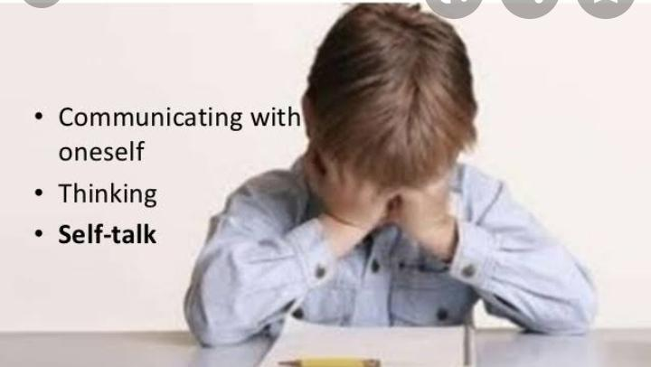
Intrapersonal Communication
Intrapersonal communication takes place within an individual.
Without an internal dialogue, one cannot proceed to the further levels of communication—interpersonal and organizational.
Self-motivation, self-determination, and the like take place at the intrapersonal level

Slide 23
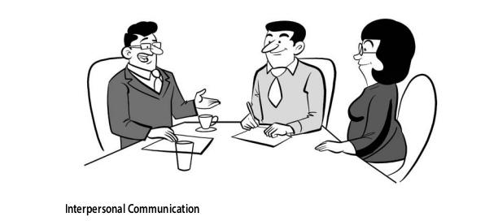
Interpersonal Communication
Communication at this level refers to the sharing of information among people.
Interpersonal communication diﬀers from other forms of communication in that there are few participants involved, they are in close physical proximity to each other, many sensory channels are used, and feedback is immediate.
The roles of the sender and receiver keep alternating.

Slide 24
Interpersonal Communication
Interpersonal communication can be formal or informal.
Most interpersonal communication situations depend on a variety of factors, such as the psychology of the two parties involved, the relationship between them, the circumstance in which the communication takes place, the surrounding environment, and ﬁnally the cultural context.

Slide 25
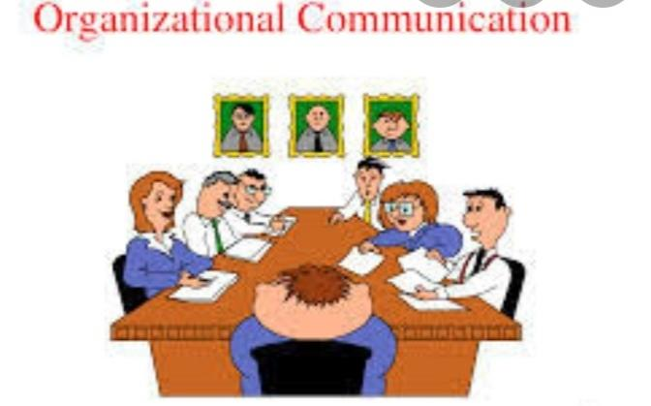
Organizational Communication
Communication in an organization takes place at diﬀerent hierarchical levels. It is extremely necessary for the growth of any organization.
With a proper networking system, communication in an organization is possible even without direct contact between employees.

Slide 26
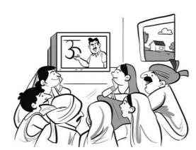
Mass Communication
Mass communication is meant for large audiences and requires a medium to transmit information.
There are several mass media such as journals, books, television, and newspapers.
The audience is heterogeneous and anonymous, and thus the approach is impersonal.
Example: Press interviews given by the chairman of a large ﬁrm.
This type of communication is more persuasive in nature than any other form, and requires utmost care on the part of the sender while encoding the message.

Slide 27
Flow of Communication (Communication Network)

Slide 28
Flow of Communication
Information flows in an organization both formally and informally
Formal communication refers to communication that follows the official hierarchy and is required to do one’s job.
Information of various kinds flowing through formal channels, such as policy or procedural changes, orders, instructions, and confidential reports, is formal communication.
Formal communication can flow in various directions—vertical, lateral, or diagonal.

Slide 29
Vertical Communication
Vertical communication consists of communication up and down the organization’s chain of command. Vertical communication can be classified as downward communication and upward communication according to the direction of its flow.

Slide 30
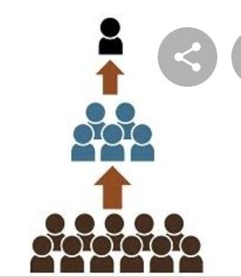
Upward Communication
From bottom to top – when reports or findings are sent to superiors. Impt. for decision making and gathering day to day information. Eg.- Form – reports, statistical analysis.

Slide 31
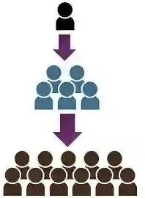
Downward communication
When managers inform, instruct, advise, or request their subordinates, the communication flows in a downward pattern.
Use: To convey routine information, new policies or procedures, seek clarification, ask for an analysis, etc.
Form: Emails, memos, notices, face-to-face interactions, or telephone conversations.

Slide 32
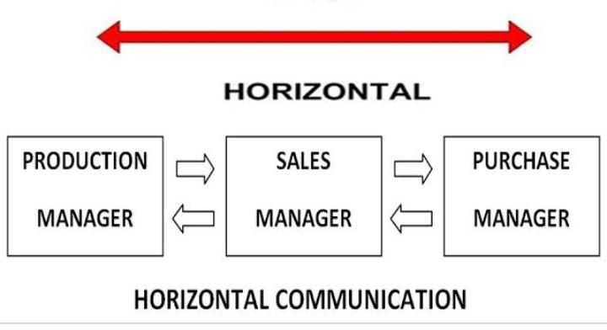
Horizontal /Lateral Communication
Takes place among peer groups or hierarchically equivalent employees at the same level
Impt. to facilitate coordination, save time, bridge any communication gap. Eg.- sharing of reports for better ideas

Slide 33
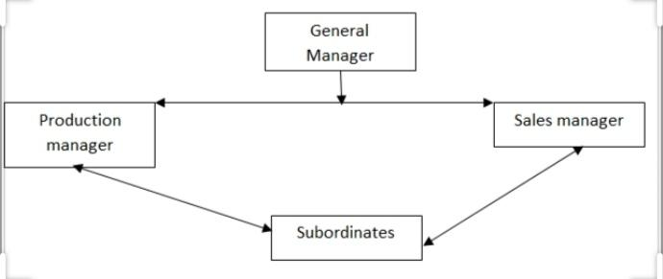
Diagonal Communication
Diagonal communication or cross-wise communication flows in all directions and across the various functions and levels in an organization.
It is deviation from the normal chain of communication but it expedites action. Eg. Sales manager communicating directly with the vice president (production) of different branch.

Slide 34
Thank You!

